Slide 1

Tim Calabrese
﻿The Many Lives of NYC's CityMap: Past, Present and Possible Future
When: Thursday, March 21 at 10 am
Where: Virtual Event
RSVP: https://tinyurl.com/4r97rmmp
Visit www.open-data.nyc to view the full program!
Notes:
Option 1

Slide 2
Thursday, March 21 at 10:00 AM
The Many Lives of NYC’s CityMap
Past, Present and Possible Future
Presented by: Tim Calabrese
Visit open-data.nyc to view the full program.
Notes:
Title Slide: Put this at the front of your presentation

Slide 3
Agenda
Questions for discussion at the end
When did you first learn of CityMap?
What were/are your impressions?
Did they change over the years?
What should CityMap be?
How can we help NYC’ers find the right map for their needs?
Overview
Who am I
Who is DoITT / OTI
Who is Esri
What is CityMap (nyc.gov/citymap)
Origin
Successes
Challenges
Redesign
Deployment
What do people think of it?
Survey of users
Comments after release
Discussion
Notes:
This isn’t really a research project or a data analytics project – its more of a narrative history
This is going to be fast – don’t worry about taking notes or copying links.

Slide 4
Why am I telling this story?
I’m Tim Calabrese (he/him)
4 years a project manager with Esri’s Professional Services
8 years at City Planning and 12 years at DOE
Hunter College Geography before that
Project Manager for the OTI NextGen GIS project
Either geographer who manage projects OR
A project manager who specializes in GIS projects
Missing from this conversation: Voices from DoITT / OTI
Invited but chose not to participate
Notes:
As a project manager, I’m not very technical and I like a lot of context

Slide 5


DoITT → OTI
New York City Department of Information Technology and Telecommunications
Mayor's Office of Data and Analytics
Mayor's Office of the Chief Technology Officer
Mayor's Office of Information Privacy
New York City Cyber Command
Algorithms Management and Policy Office
NYC 311
Office of Technology & Innovation

Slide 6
OTI Services
Deliver City IT services including hardware, software and technical support.
Support sharing and management of citywide data and information.
Regulate franchised cable services.
Regulate provisioning of public telecommunication services on City streets.
Arrange for free, fast, and reliable internet access to eligible NYCHA residents.
Accelerate and simplify the delivery of City services and modernize supporting technologies.
2023_mmr.pdf (nyc.gov)

Slide 7
OTI Overview
OTI Oversimplified
Apps
CityMap, Hurricane Evacuation Zone Finder, Crime, Then & Now, Street Closures, Crime Victim Services, etc
311
GIS
Tech Services
911
Data
CSCL, Building footprints, orthos, LiDAR, planimetrics, 3D models
Cyber Command
NYC Media
Services
Basemap services
Geoclient geocoding services

Slide 8
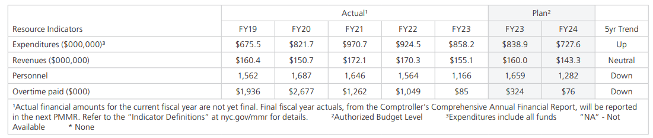
Agency Resources
2023_mmr.pdf (nyc.gov)
Notes:
The GIS Unit had been without a director since 2018, though they did have one for a short time between January and August of 2022. The GIS data team, while much smaller than it once was, continue to produce CSCL, orthoimagery, planimetrics and building footprints datasets, but they too lost their manager in 2022. A handful of GIS developers are still at OTI. Since 2021, their work seems to have involved updating Geoclient and migrating to AKS.

Slide 9
Potential Impacts
“With Phase 1 [of the Second Avenue Subway] complete, knowledge and lessons learned from Phase 1 have been retained by the consultant teams, and many of the most experienced managers from Phase 1 who learned by doing have left the agency, some have retired and others now work in the private sector. An agency staffer at another large North American agency we spoke to about its reliance on consultants explained that at her agency, it was the consultants who knew everything about past projects rather than agency staff.”
In any case, the benefits of hired guns apparently do not justify the evisceration of public-sector expertise. “Consultant teams need a client who knows what it wants and is technically competent enough to direct the consultants,” the Transit Costs Project concludes
Subway costs: we finally know why it costs so much to build public transit in the U.S. (slate.com)
Notes:
This loss of staff presents a challenge to consultants because there aren’t enough informed decision makers

Slide 10

Esri Simplified Overview
Esri Oversimplified
CityMap Launch - 2006
Partial timeline
ArcView GIS 1992
ArcIMS 1997
ArcGIS Server 2004
REST API 2008
ArcGIS 10 2010
ArcGIS Online 2012
ArcGIS Pro 2015
ArcGIS 11 2022
Tightly scripted software code
Object relational software
Service-oriented architecture
Cloud computing
Notes:
The Product team makes products like ArcGIS
The Sales team sells those products – they do so in situations where they think it will be a good fit
The Consulting team is a product, but usually involved in implementing something the Product team has made
Sales and Consulting teams bring back information to the Product team to improve the product

Slide 11
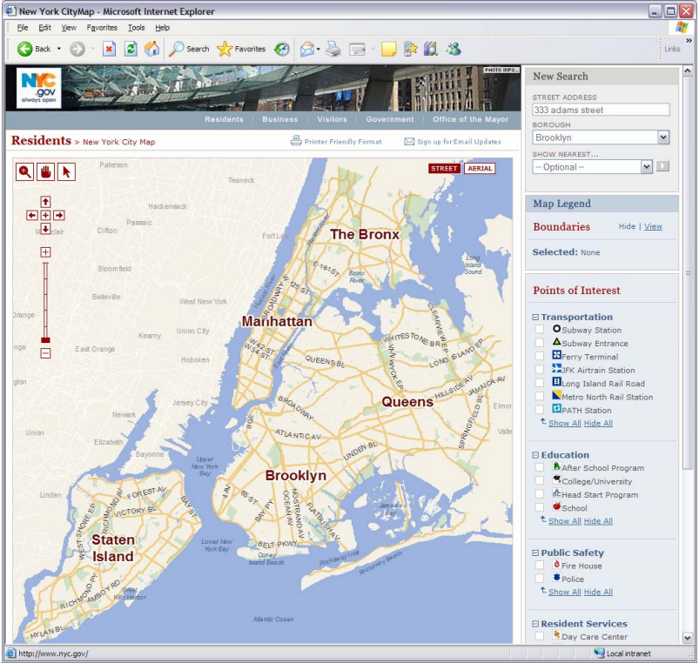
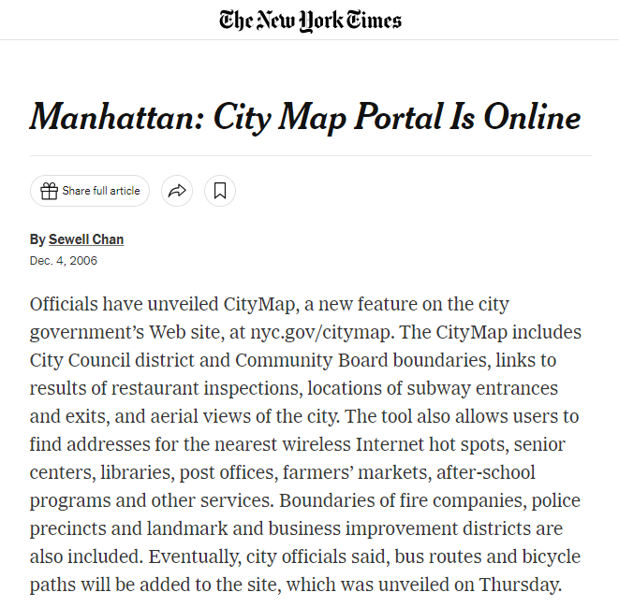
CityMap Launch 2006

Slide 12
Challenges Met and Overcome
Original CityMap built with ArcIMS
Esri advised to switch to ArcGIS Server
Migration was not successful
DoITT rebuilt CityMap in GeoServer and OpenLayers
Open source and Open standards with low maintenance costs
CityMap is a continued success
Notes:
DoITT chose ArcGIS Server for Linux over Windows
Open Geo stack = $40K per year for maintenance ona stack of over 100 virtual machines
Don’t have to update the entire stack at once – can address individual components

Slide 13
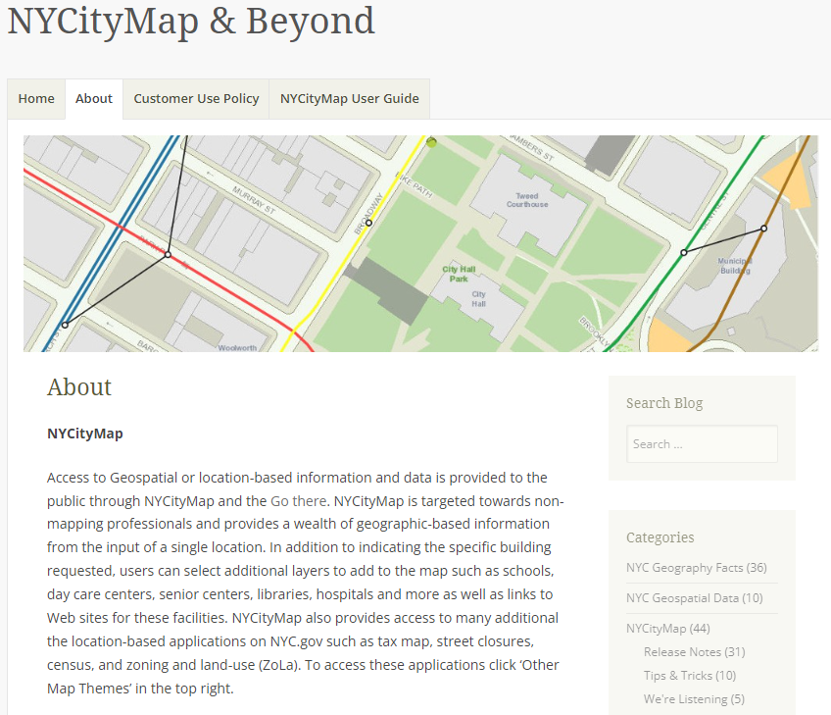
Continued Development 2010-2018
DoITT GIS maintained a blog for seven years, including:
Release notes
Tips & Tracks
Feedback from users
Geography Facts
Data Details and Metadata
Even though the original CityMap is no longer available, the blog is:
https://nycitymap.wordpress.com

Slide 14
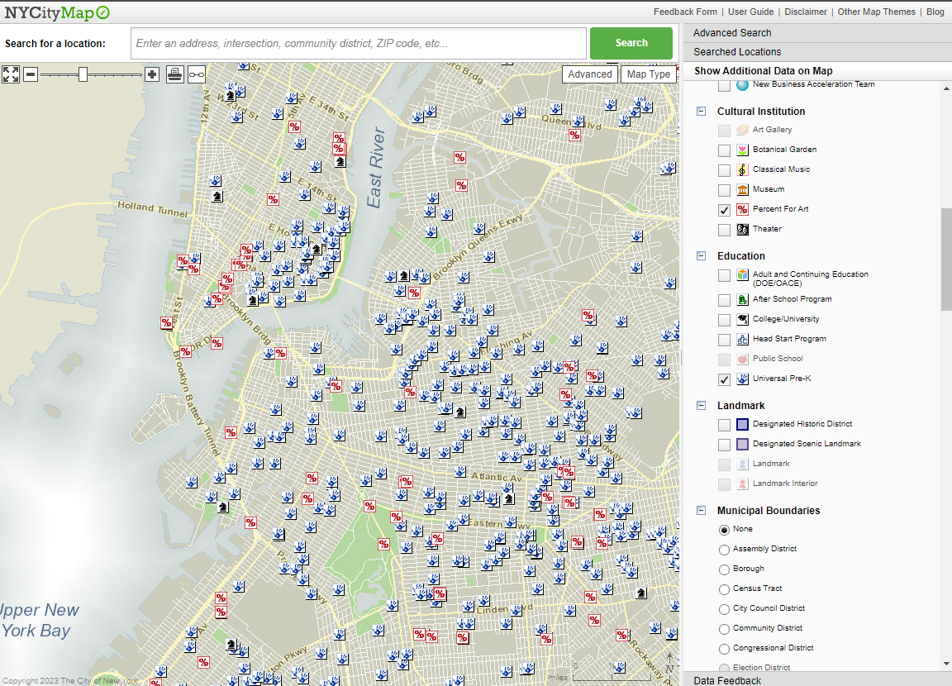
NYCityMap Features
Search by
Info about Searched Locations
Overlay Additional Data on Map
Collect Data Feedback
Swap Background Maps
Street map (Vector Basemap)
Various aerial images
Pan, Zoom, Measure, Email
Address
Place of Interest
Intersection
Borough / Block / Lot
Community District
City Council District
Coordinate
BIN
Neighborhood
ZIP Code
Street Between Intersections

Slide 15
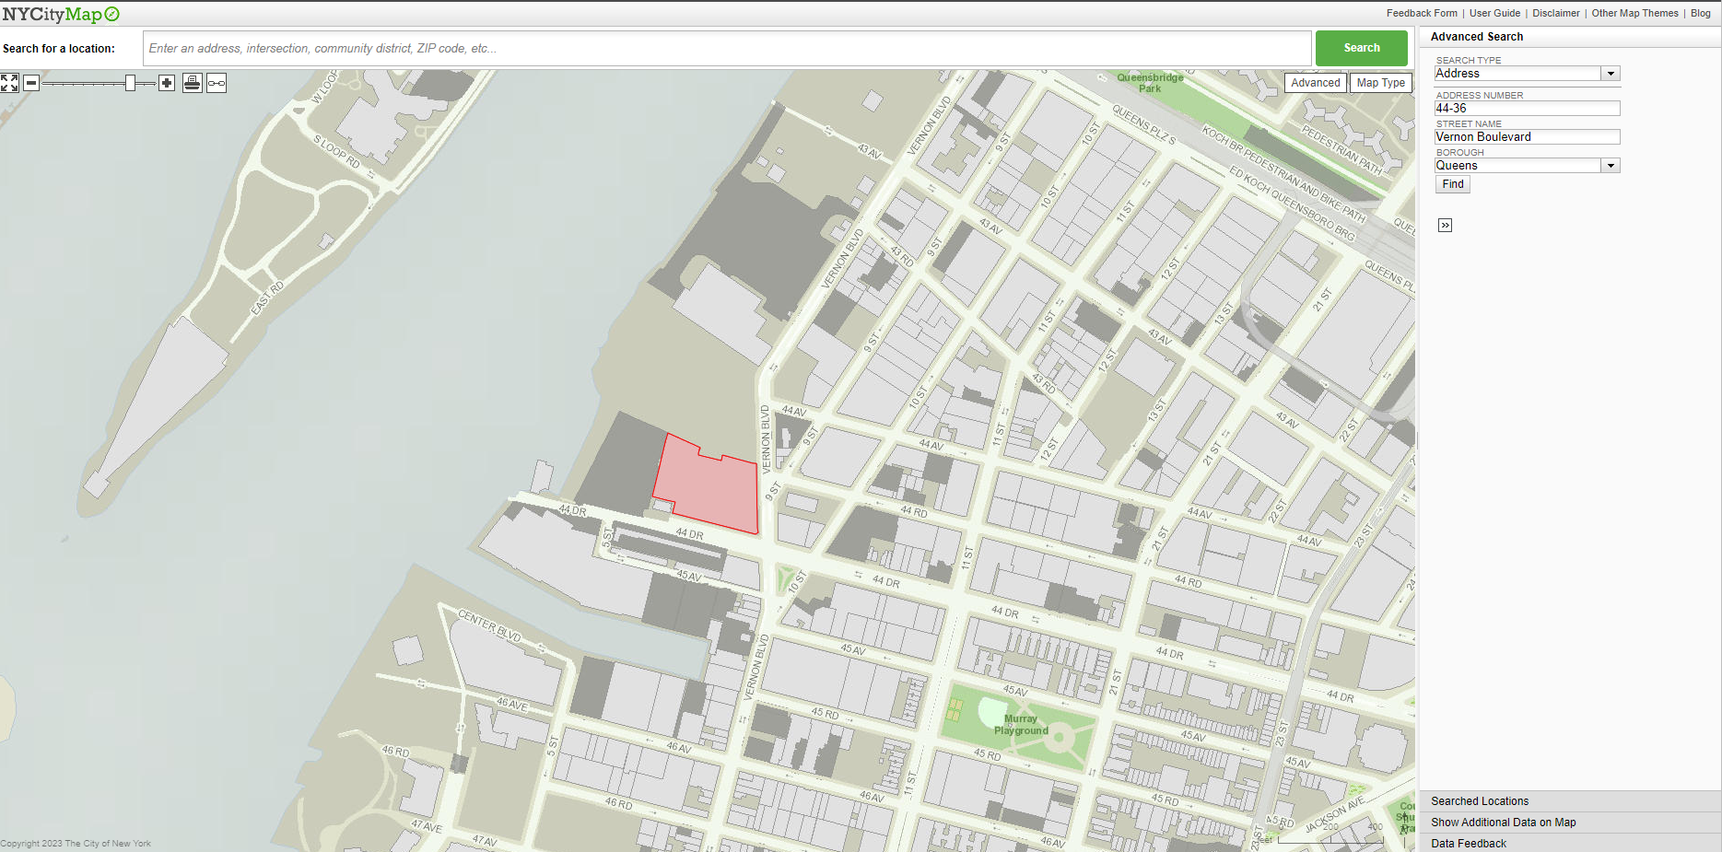
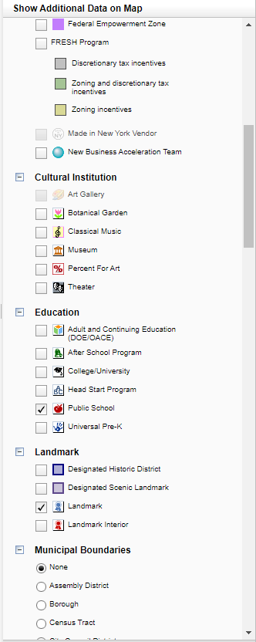
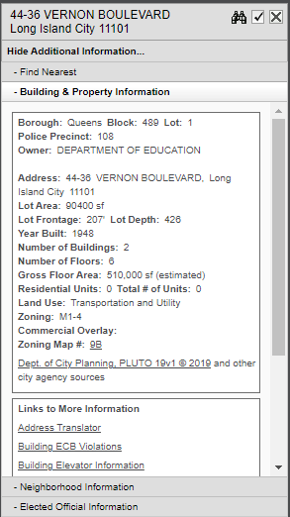
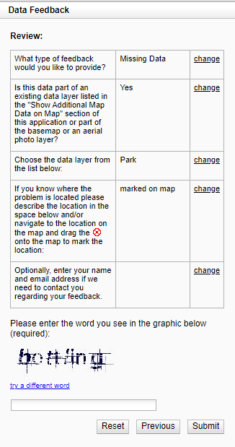
NYCityMap Features
NYCityMap Features
Show Additional Data
Enter Location Search
Selected Locations
Data Feedback

Slide 16
NYCityMap Challenges
100+ Layers
Capital Projects
Capital Projects Dashboard
Design/Construction
Federal Stimulus
NYC DOT 10 Capital Plan
NYC DOT Protected Streets
City Programs
Broadband Technology and Opportunities Programs
TWC Learning Lab
Business Improvement Districts
Empire Zones
Federal Empowerment Zone
FRESH Program
Made in NY Vendor
New Business Acceleration Team
Education
Adult and Continuing Education
After School Program
College/University
Head Start Program
Public School
Universal Pre-K
Municipal Boundaries
Assembly Districts
Borough
Census Tract
City Council
Community District
Congressional District
Election District
Fire Battalion
Fire Company
Fire Division
Municipal Court District
NYPD Patrol Borough
Police Precinct
Sanitation Cleaning Section
School District
State Senate District
United Hospital Fund Neighborhood
ZIP Code
Service Centers
Aging
Buildings
Child Services
City Clerk
City Planning
Citywide Administrative Services
Civilian Complaint
Correction
Consumer Affairs
Environmental – DEP
Finance
Financial Empowerment Center
Fire
Homeless Services
Housing HPD
Human Rights
Human Rights – HRA
NYCHA
Parks & Recreation
Police
Records
Sanitation Special Waste Drop-off
Small Business Services Business Solution
Small Business Services Workforce 1 Center
Taxi & Limousine
Transportation
Trials & Hearings
City Life
Green Market
Park
Public Beach
Kayak/Canoe Launch
Public Pool
Recreation Center
Spray Fountain
Water Fountain
Public Wifi Hotspot
Landmarks
Designated Historic District
Designated Scenic Landmark
Landmark
Landmark Interior
Resident Services
Day Care Center
Homeless Services – Homebases
Homeless Services – Law Project
Hospitals
Library
Post Office
Senior Center
Transportation
Airport
AirTrain JFK
Bicycle Parking
DOT Truck Routes
Ferry Terminal
Long island Railroad
Metro North Railroad
Municipal Garage
New Jersey Transit
Off-street Parking
PATH
Staten Island Railway
Subway
Subway Station Entrance
Traffic Camera
Public Safety
EMS Station
Fire House
Police Precinct House
Youth Services
Fatherhood Initiative
Literacy Program
Out-of-School Youth Program
Runaway and Homeless Youth Center
Summer Youth Employment Program
Young Adult Internship Program
Water Quality
Bathing, Boating Fishing, Shellfishing
Bathing Boating, Fishing
Limited bathing, Boating, Fishing
Boating, Fishing
Fishing Only
Cultural Institution
Art Gallery
Botanical Garden
Classical Music
Museum
Percent For Art
Theater
Notes:
Can be hard to

Slide 17
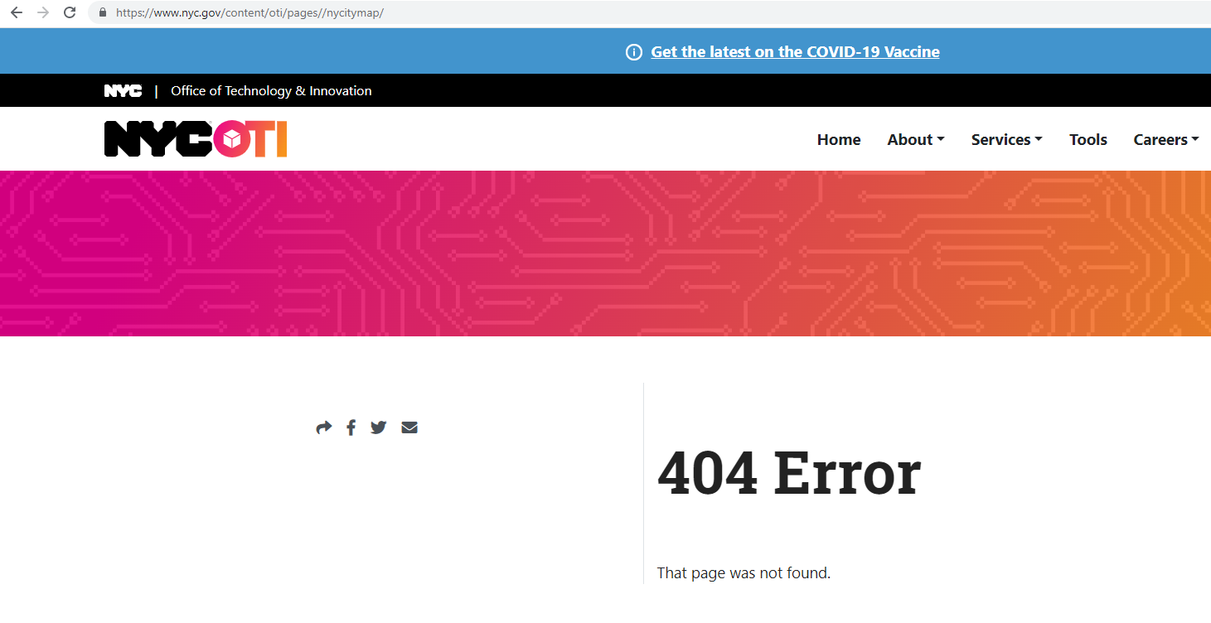
NYCityMap Challenges
Challenges
Didn’t load from OTI website in Chrome
Building & Property Info not updated since 2019
Aerial Imagery not updated since 2018
Metadata and blog not updated
Cannot view data in table form
Cannot download data

Slide 18
NYCityMap Challenges
Design Challenge
Maybe map portals like CityMap aren’t the best design choice
Showcase apps (aka ‘kitchen sink apps’) begin to lose favor
Hick’s Law: the time required to reach a decision will increase logarithmically with the number of choices available.
Focus on single purpose map apps, like Food Help and Vaccine Finder
…but – people still like CityMap!

Slide 19
NYCityMap Challenges
NextGen GIS Project 2021
Two-year project to re-platform GIS at OTI
Retire end of life infrastructure
Migrate geospatial data and apps to Esri and Azure
Follow a “SaaS/Cloud-first” design to reduce on-prem footprints
Deliver shared geospatial services (basemaps, locators, imagery, 3D)
Facilitate sharing between City Departments
Rapidly deploy apps (configurable, Commercial of the Shelf (COTS)-first and custom when needed)
Reduce
O & M
Costs
Retire End
of Life Apps
Empower OTI Staff
Notes:
Retire end of life infrastructure = physical oracle servers at end of warranty

Slide 20





NYCityMap Challenges
OTI WebGIS Architecture
311 Apps
Mobile, CRM and Portal
Custom Apps
Childcare Finder (DSS)
Food Help Finder (DSS)
Vaccine Finder (DOHMH)
COVID Test Site Finder (HH)
Crime Victim Services Finder (MOCJ)
Cooling Centers (EM)
Hurricane Evacuation Zone Finder (EM)
NYCmaps Hub
Data services & NYCmaps Explorer
Locator services
Basemap Services
Guidance and best practices
App Gallery
Developer Resources
NYCmaps (AGOL)
+
ArcGIS Enterprise on Kubernetes
Azure AD
Desktop
Public
COTS Apps
Homebase Finder (DSS)
Wheelchair Accessible Restaurants (DOHMH)
Crime Map (NYPD)
SBS Service Finder (SBS)
Street Closures (DOT & CECM)
Imagery and LiDAR Downloader (OTI)
Now & Then (OTI)
CityMap Lot Lookup & Explorer (OTI)
Apps
Apps to Support Agency Needs
School Kitchens Dashboard and Survey
Food Help Dashboard and Survey
Community Engagement Tracker
APIs
Data
CSCL (weekly)
Building Footprints (weekly)
Aerial Imagery (all years)
Real-time GIS Service (e.g. Geotab or 311)
3D Data & LiDAR
311 Service Requests (TBD)
Other vector data and web maps used in apps
Carto Resources
Imagery basemap
Basic Vector basemap
Gray vector basemap
Symbols and icons
Locators
Address
Intersection
Points of Interest
Notes:
One of the apps we’ve been asked to migrate was CityMap, but as we analyzed it, OTI GIS leaders realized that the legacy app was too complicated and they didn’t want us to replicate it exactly as it was.
250 datasets in the Hub

Slide 21
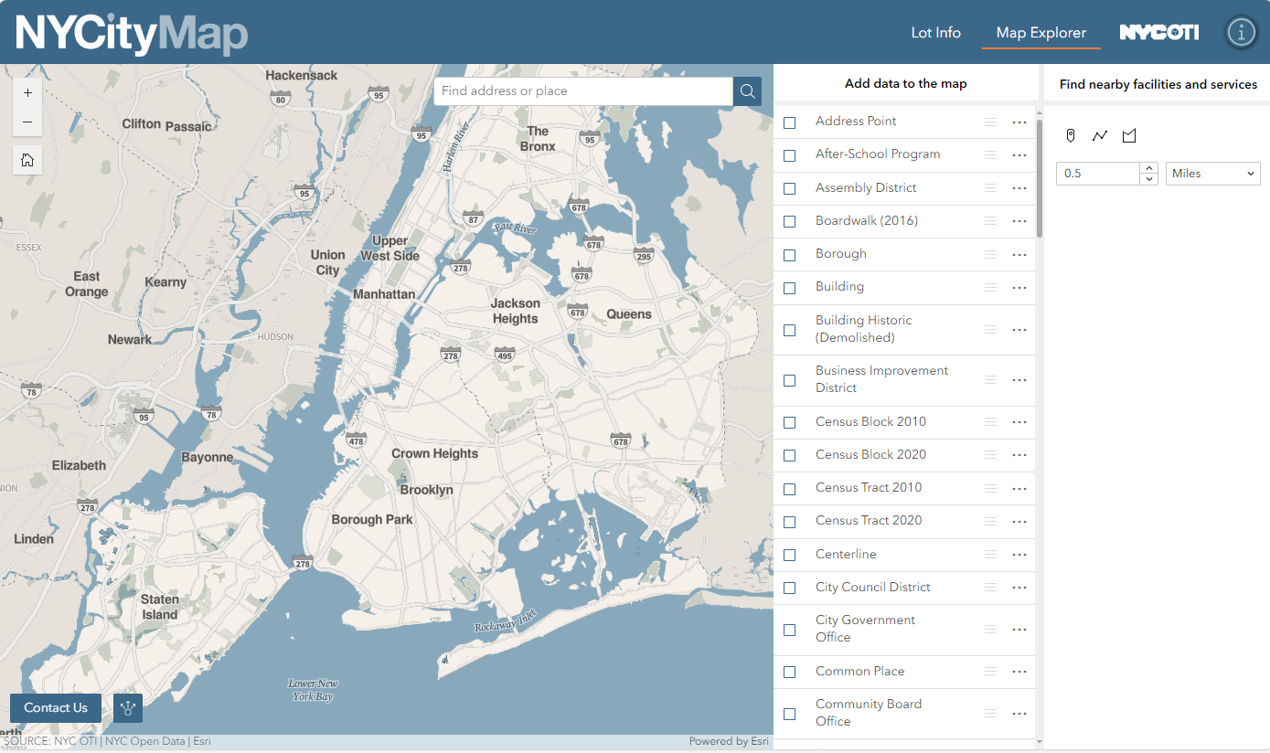
NYCityMap Challenges
CityMap 2.0
gis.nyc.gov/citymap

Slide 22









NYCityMap Challenges
CityMap 2.0
DOB Buildings
DCP FacDB
CityMap + Map Explorer
(ExperienceBuilder)
Web Map
CSCL
NYC Maps
(AGOL)
DCP MapPLUTO
Lot Info (Instant Apps)
Web Map
NYS Board of Elections
City Council

Slide 23
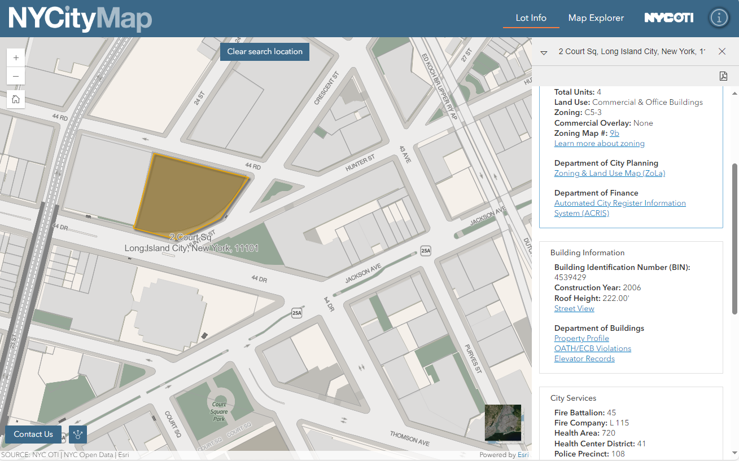
CityMap 2.0 – Lot Info
NYCityMap Challenges
Lot Info
Location Search
Property Information
Links to other resources
Other
geographies
Basemaps

Slide 24
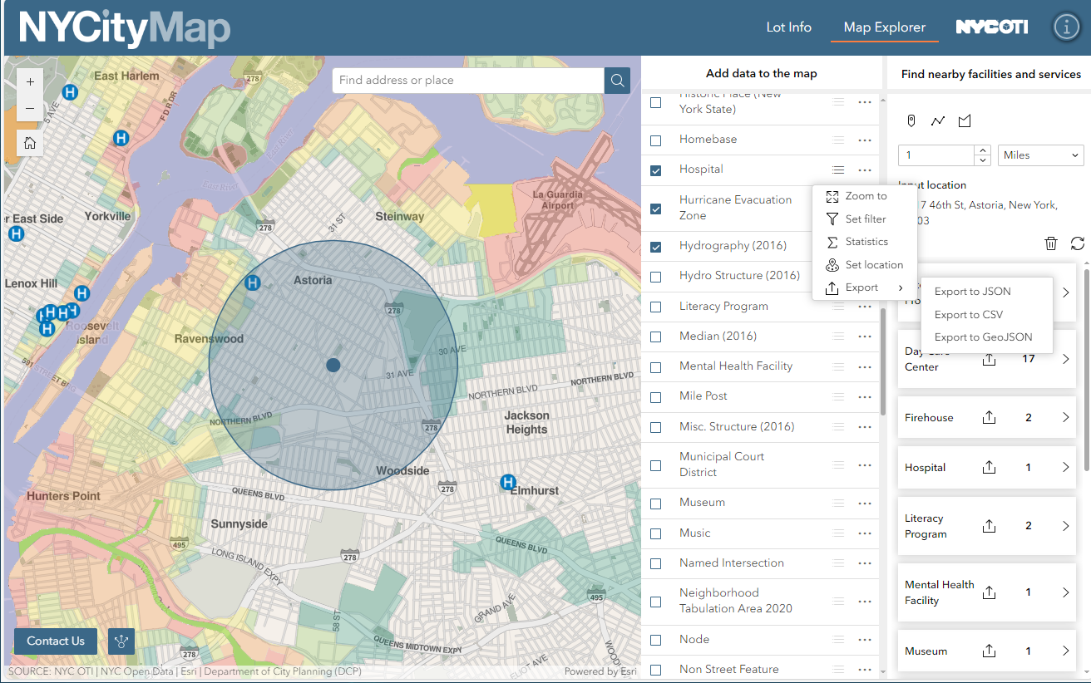
CityMap 2.0 – Map Explorer
NYCityMap Challenges
Map Explorer
Layer toggle
Export layers or tables
Find nearby points

Slide 25
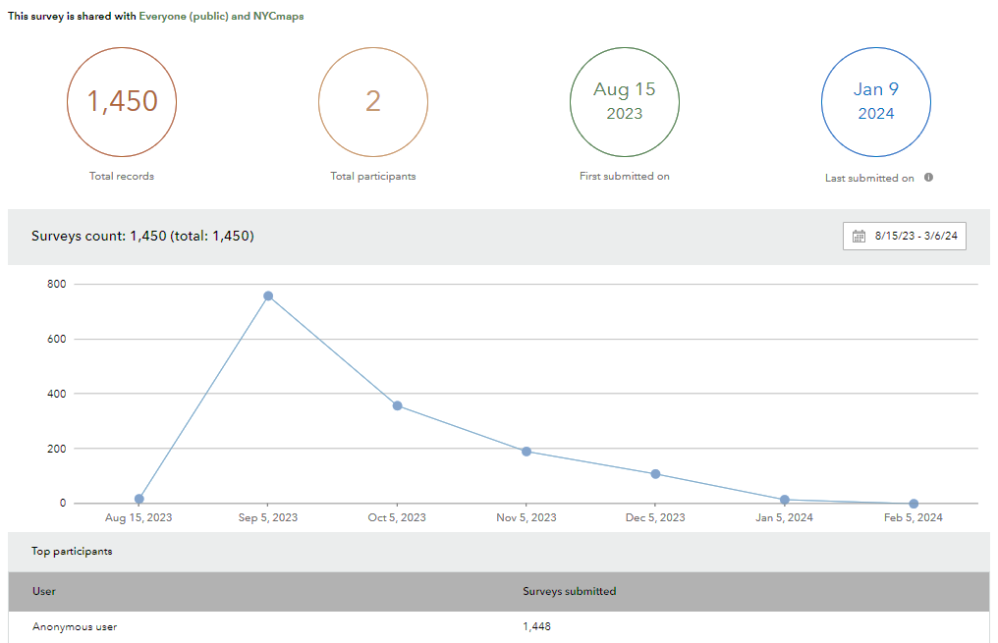
CityMap 2.0 – Survey
NYCityMap Challenges
Survey of Users

Slide 26
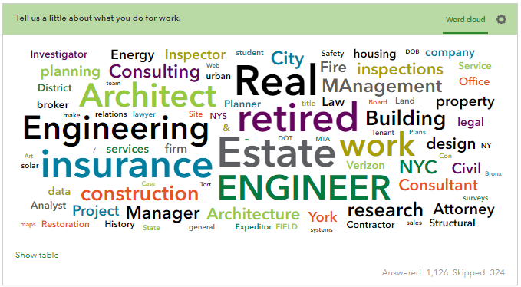
Tell us a little about what you do for work
NYCityMap Challenges
Survey Responses
Notes:
In the presentation I will show several word clouds. Word clouds have several issues but in this context they are intended for discussion to foster discussion

Slide 27
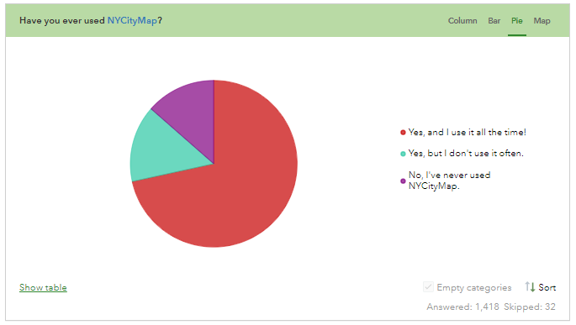
Q 2. Have you ever used NYCityMap?
NYCityMap Challenges
Survey Responses
Have you ever used NYCityMap?

Slide 28
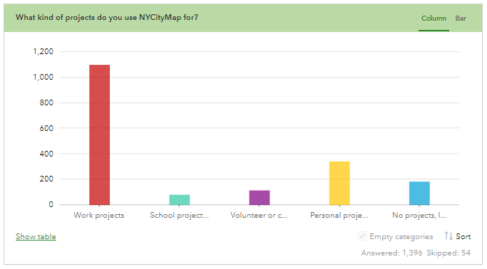
What kind of projects do you use CityMap for?
NYCityMap Challenges
Survey Responses

Slide 29
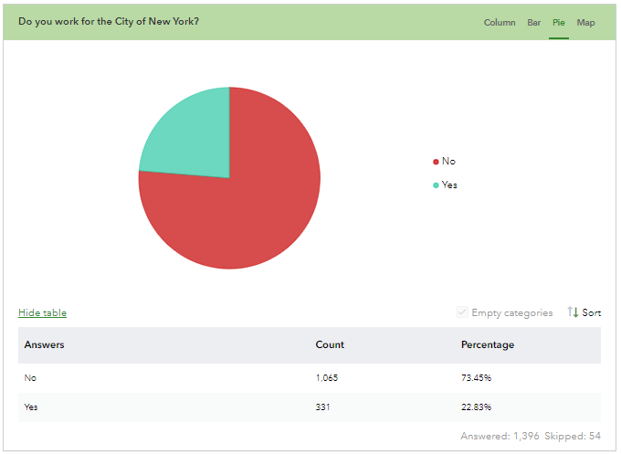
Do you work for the City of New York?
NYCityMap Challenges
Survey Responses

Slide 30
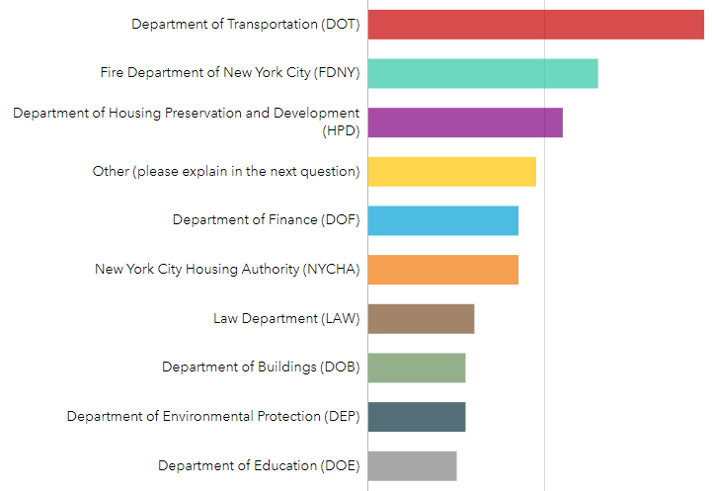
Which agency do you work for?
NYCityMap Challenges
Survey Responses
Notes:
DOT = 38, FDNY = 26, HPD = 22, Other = 19, DOF = 17, NYCHA = 17, Law Department = 12

Slide 31
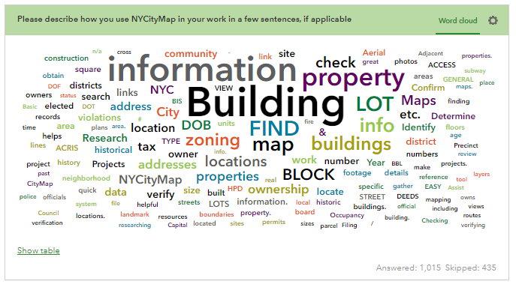
Please describe how you use CityMap in your work in a few sentences
NYCityMap Challenges
Survey Responses

Slide 32
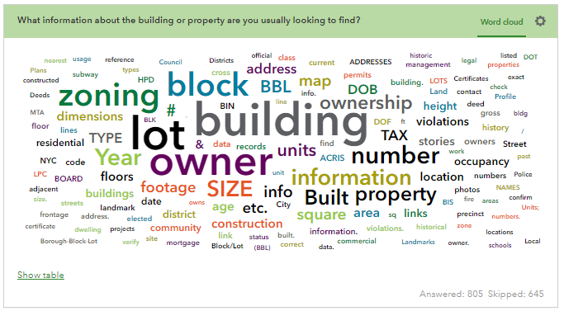
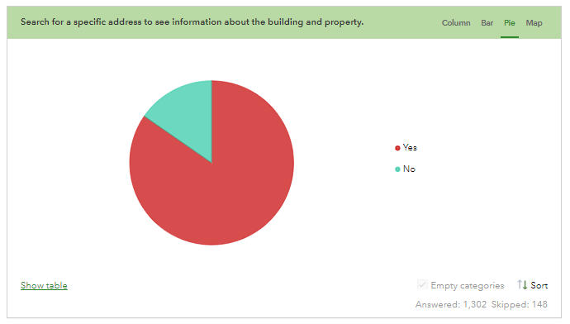
Search for a specific address to see information about the building and property
NYCityMap Challenges
Survey Responses
What information about the building or property are you usually looking to find?

Slide 33
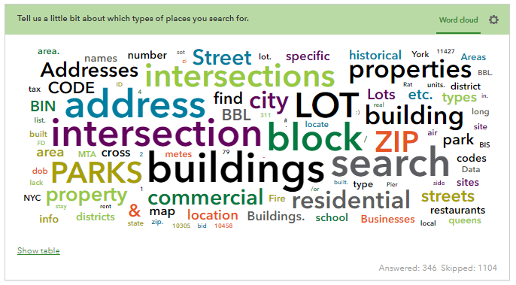
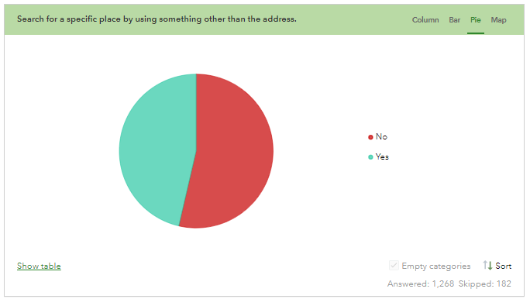
Search for a specific place by using something other than the address
NYCityMap Challenges
Survey Responses
Tell us a little bit about which types of places you search for

Slide 34
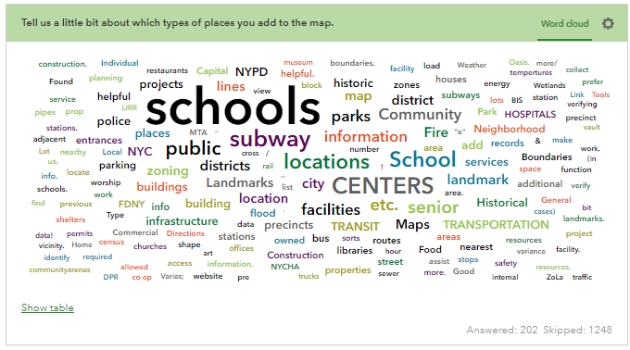
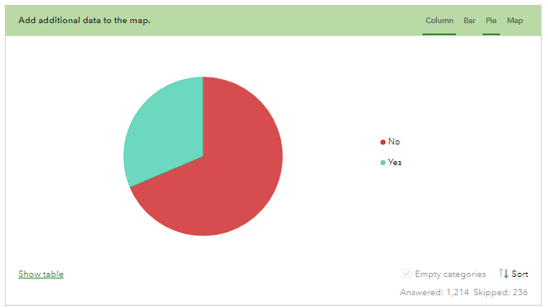
Add additional data to the map
NYCityMap Challenges
Survey Responses
Tell us a little bit about which types of places you add to the map

Slide 35
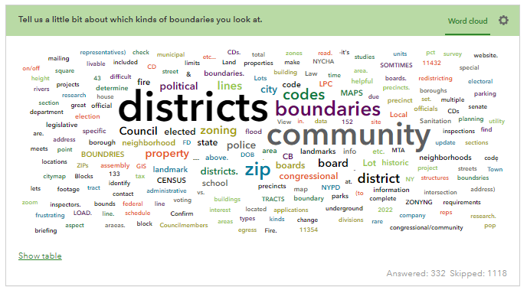
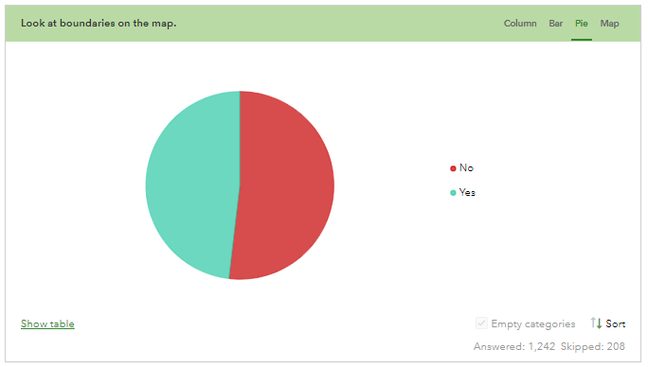
Look at boundaries on the map
NYCityMap Challenges
Survey Responses
Tell us a little bit about which kinds of boundaries you look at.

Slide 36
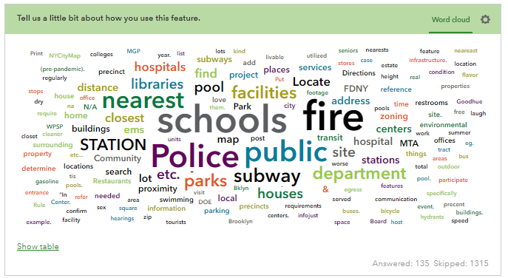
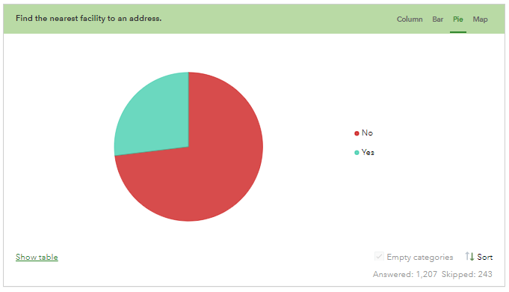
Find the nearest facility to an address
NYCityMap Challenges
Survey Responses
Tell us a little bit about how you use this feature

Slide 37
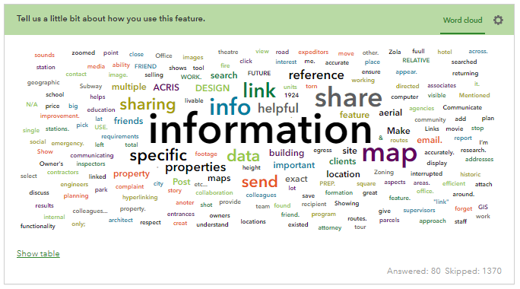
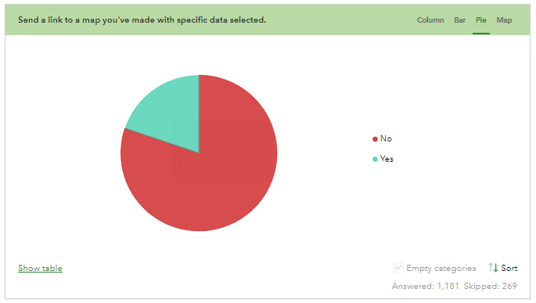
Send a link to a map you’ve made with specific data selected
NYCityMap Challenges
Survey Responses
Tell us a little bit about how you use this feature
Notes:
Because so many people skipped this, we thought it might be less important and did focus on it

Slide 38
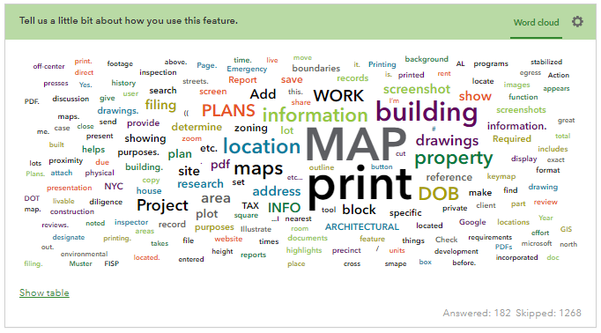
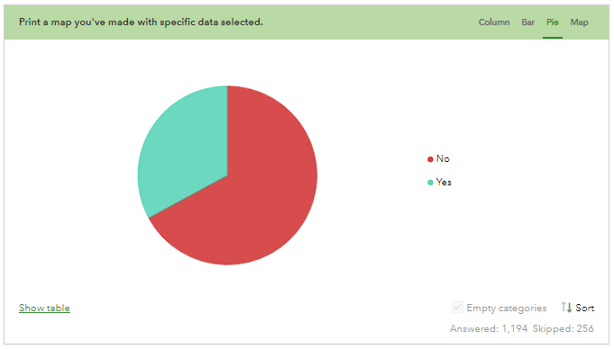
NYCityMap Challenges
Survey Responses
Tell us a little bit about how you use this feature
Print a map you’ve made with specific data selected

Slide 39
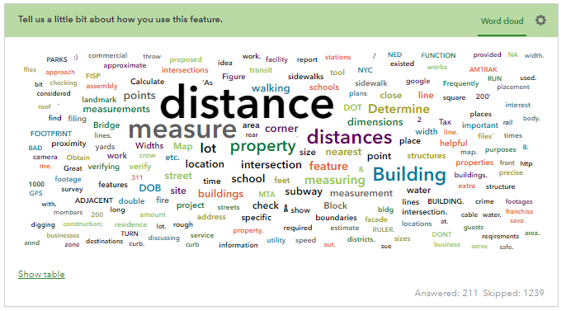
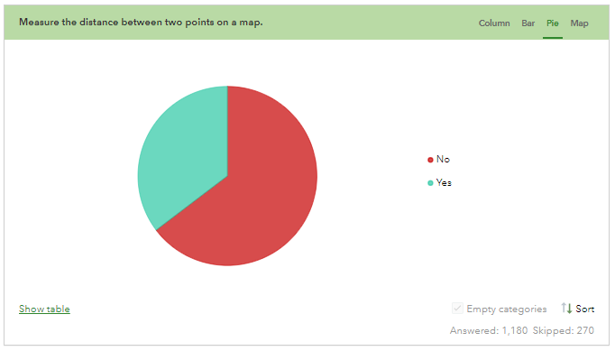
NYCityMap Challenges
Survey Responses
Tell us a little bit about how you use this feature
Measure the distance between two points on a map

Slide 40
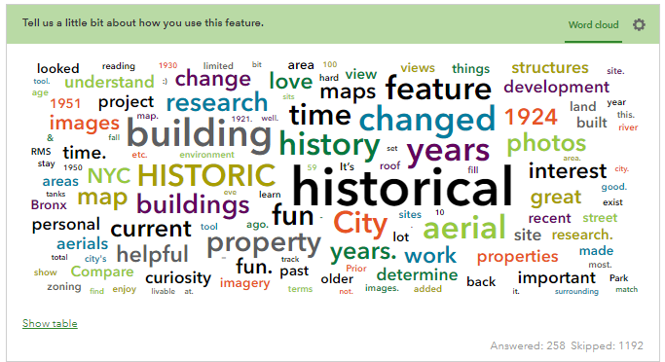
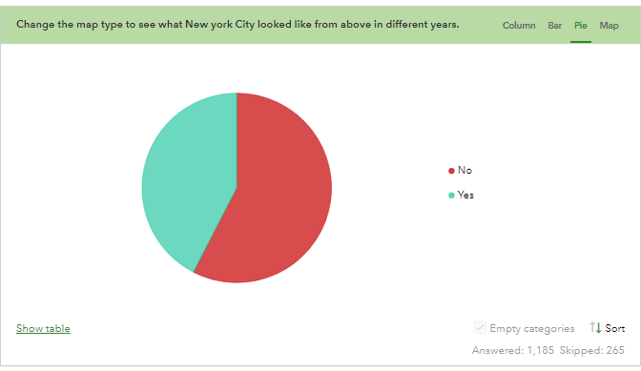
NYCityMap Challenges
Survey Responses
Tell us a little bit about how you use this feature
Change the map type to see what New York City looked like from above in different years

Slide 41
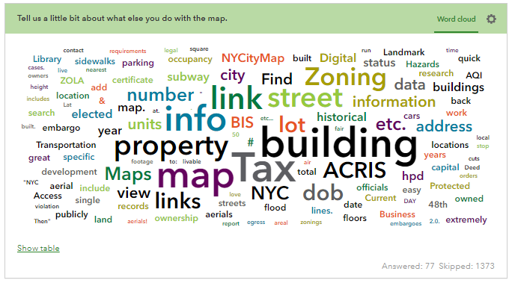
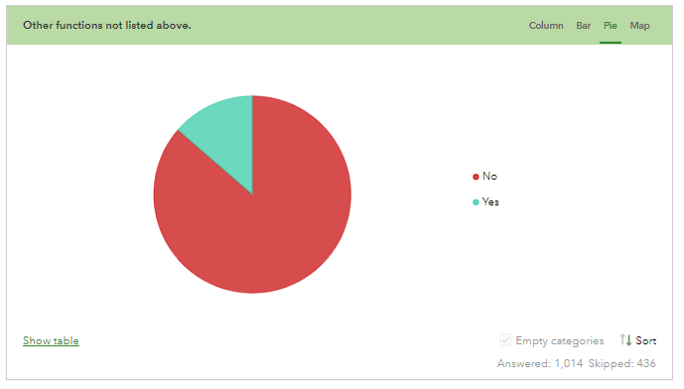
NYCityMap Challenges
Survey Responses
Tell us a little bit about what else you do with the map
Other functions not listed above.
Notes:
Key point – this survey was released before DOF’s Property Information Portal launched

Slide 42
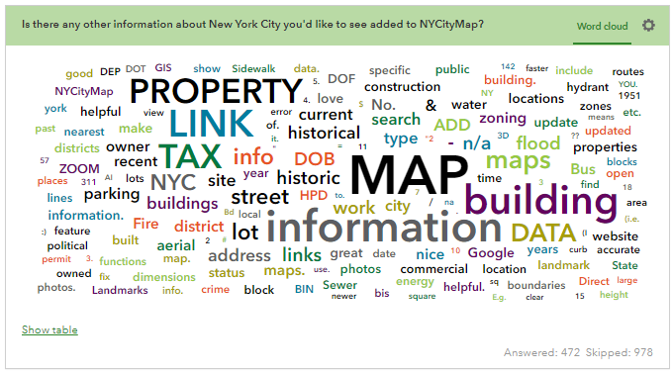
NYCityMap Challenges
Survey Responses
Is there any other information about New York City you'd like to see added to NYCityMap?

Slide 43
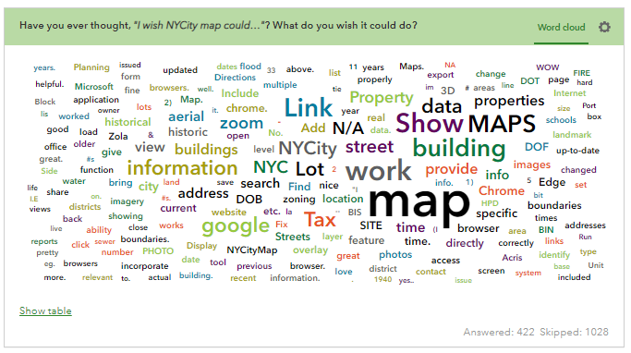
NYCityMap Challenges
Survey Responses
Have you ever thought “I wish NYCitymap could…”? What do you wish it could do?

Slide 44
NYCityMap Challenges
Passionate Responses
“In my prior work in the City Council, I used it to investigate constituent cases on a near daily basis. In my work now, I use it mostly to look up district lines. “
“I've used this application for several years in a photography project called "Changing New York." It's modeled after Berenice Abbott's work of the same name. Students photograph a building of significance in NYC then research what it looked like in the 40s and 80s. We compile their photos with the tax images and examine how New York has changed, or remained, over the last eighty years.”
“We write briefings regarding our sites and what are the places of interest for the older adults in the community. We see how to make it a little easier to navigate their communities.”
Notes:
Teachers
Lawyers
Retirees
Community Advocates
Civil Servants

Slide 45
NYCityMap Challenges
Analysis and Synthesis
Reliability and Compatibility
The current version works on all browsers (much better on desktop than mobile)
Some people have reported issues with the Export function; in our testing it seems like these are related to pop-up blockers
Geocoding and Search
Users can search in Lot Info by Address, Borough-Block-Lot or Building ID number.
Some users are looking for intersections and on-from-to – this is coming
Additional and Custom Overlays
Subway lines, DOT protected streets, sewer mains, water mains, bus routes
New Visualizations and Historical Context
3D buildings and land-forms
Tax lot photos, iCARDS (https://www.whfirm.com/nyc-housing-mysteries-card/)
Street view
Historical aerial imagery
Enhanced Features and Usability
Raster and Vector data outputs
A measuring tool/widget
Links to Certificates of Occupancy
Adding Pins and Saving Addresses
Contacting Representatives
Historical Research and Data Enrichment
Sanborn insurance maps
Historical spatial data
LPC links

Slide 46
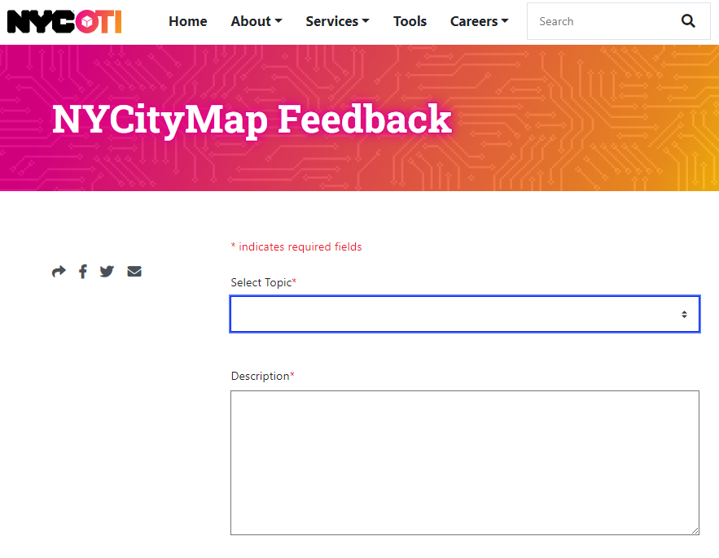
NYCityMap Challenges
Post Deployment Comments
Since CityMap was deployed in January, OTI has fielded over 100 comments from users
OTI responding to comments via email
Suggestions go into a backlog of action items
OTI Developers are learning to support the app
First up: replace 2016 planimetric layers with 2022 versions

Slide 47
NYCityMap Challenges
Summary
When did you first learn of CityMap?
What were/are your impressions?
Did they change over the years?
What should CityMap be?
How can we help NYC’ers find the right map for their needs?

Slide 48
NYCityMap Challenges
Links
NYCityMap: gis.nyc.gov/citymap
Presentation: https://github.com/timcala37/citymap-feedback
Some others
Property Information Portal: gis.nyc.gov/taxmap
Then and Now: finder.nyc.gov/thenandnow
Imagery and LiDAR Downloader: finder.nyc.gov/orthoimagery
Esri Developer resources: https://developers.arcgis.com/
2006 Esri UC paper: 2006 Esri UC NYC SOA - Search (bing.com)

Slide 49
Thank you for participating in Open Data Week!
Join us at more events through Sunday, March 24. View the program at open-data.nyc.
Notes:
End Slide: Put t

